Slide 1
Titanic Survival Prediction
Sebastian Grassmé
Introduction to Machine Learning: Supervised Learning
University of Colorado Boulder
18th of October 2023

Slide 2
Agenda
Introduction
Data Overview
EDA Insights
Cabin Column
Preparing the Data
Model Prediction Results
Revisiting Cabin Column
Conclusion

Slide 3

Introduction
Kaggle's Titanic Prediction Competition
Kaggle have a prediction competition, in which the goal is to get as close as possible to predict the survival of passengers aboard the Titanic.
Models Used:
Logistic Regression
Random Forest

Slide 4
Data Overview
PassengerId | Survived | Pclass | Name | Sex | Age | SibSp | Parch | Ticket | Fare | Cabin | Embarked
1 | 0 | 3 | Braund, Mr. Owen Harris | male | 22.0 | 1 | 0 | A/5 21171 | 7.2500 | NaN | S
2 | 1 | 1 | Cumings, Mrs. John Bradley (Florence Briggs Th... | female | 38.0 | 1 | 0 | PC 17599 | 71.2833 | C85 | C
3 | 1 | 3 | Heikkinen, Miss. Laina | female | 26.0 | 0 | 0 | STON/O2. 3101282 | 7.9250 | NaN | S
4 | 1 | 1 | Futrelle, Mrs. Jacques Heath (Lily May Peel) | female | 35.0 | 1 | 0 | 113803 | 53.1000 | C123 | S
5 | 0 | 3 | Allen, Mr. William Henry | male | 35.0 | 0 | 0 | 373450 | 8.0500 | NaN | S
Key Data Columns:
Our dataset contains information like
Passenger class (Pclass)
Age
Sibling/spouse count (SibSp)
Parent/child count (Parch)
Embarkation port (Embarked)
Missing Values:
There are missing values in the Age, Cabin, and Embarked columns.
Notably most of the values in the Cabin column is null.

Slide 5
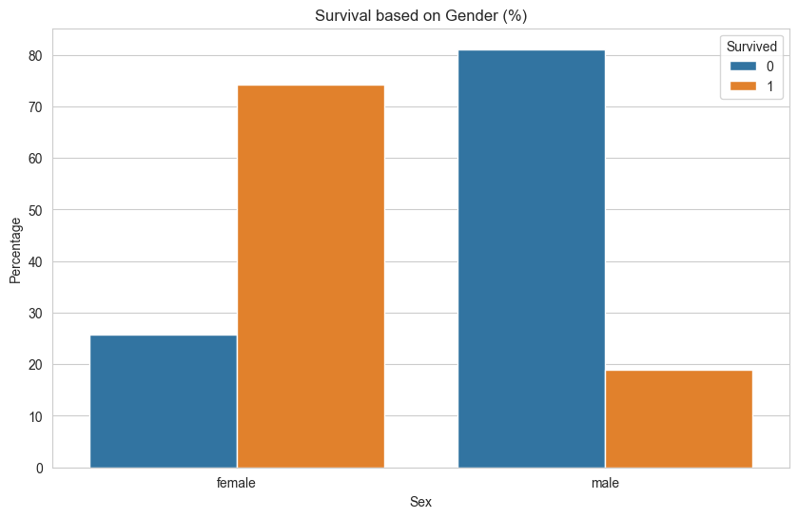
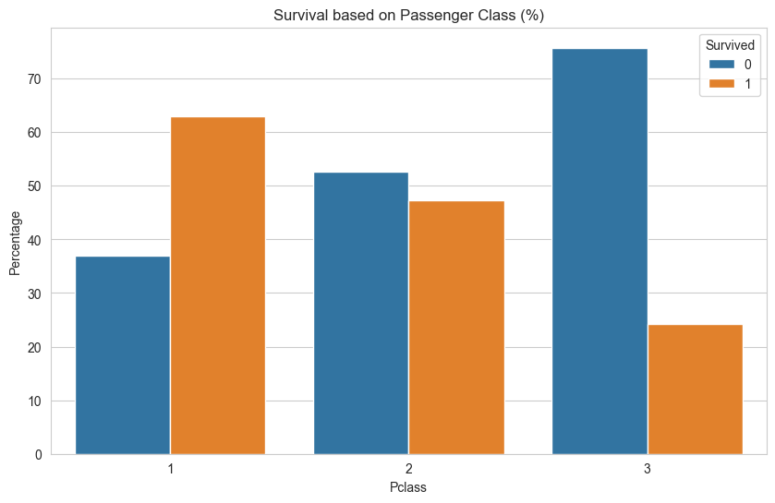
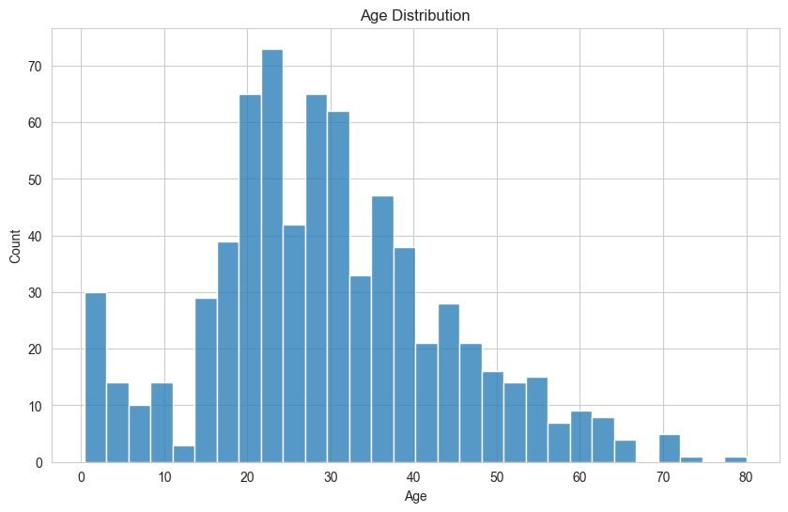
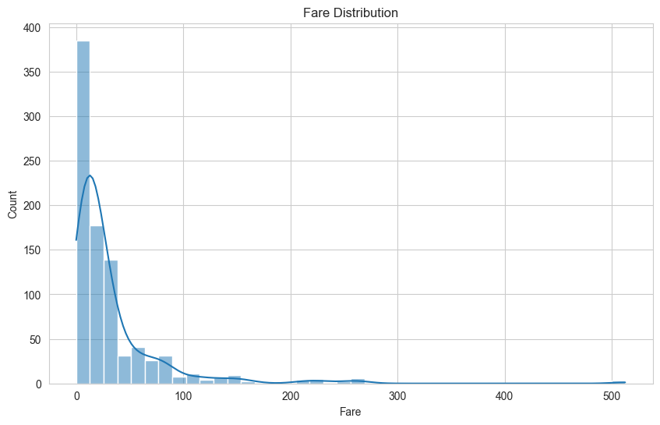
EDA Insights
Gender-based Survival
Survival by Pclass
Age Distribution
Fare Distribution
Females had a significantly higher survival rate compared to males.
First-class passengers had the highest survival rate.
3rd-class passengers had a survival rate of 25%.
Most passengers are between 20-40 years old.
A lot of children under the age of 10.
Most of the passengers have bought the cheapest fare.
Very small number of passengers had a ticket over $100.

Slide 6
EDA Insights Cabin Column
Data Population:
The dataset only have 22% of the rows populated with a Cabin value.
Value Samples:
C85, C123, E46, G6, C103, D56, A6
Unique Cabin Values:
Despite missing values, the available cabin data points to specific deck information, e.g., C85 indicates deck C.
Observation and Assumption:
The Cabin column has numerous missing values. We hypothesize that the cabin location might influence survival, given its relation to ship structure.

Slide 7
Preparing the Data
Handling Null Values:
Filled Age with median values. Dropped rows with missing Embarked values. Cabin remains under consideration.
data.drop(["Cabin"], axis=1, inplace=True, errors="ignore") data['Embarked'].fillna(data['Embarked'].mode()[0], inplace=True) data['Age'].fillna(data['Age'].median(), inplace=True)
One-hot Encoding:
Converted categorical columns like Sex and Embarked into numerical representations.
data['Sex'] = data['Sex'].map({'male': 0, 'female': 1})
embarked_dummies = pd.get_dummies(data['Embarked'], drop_first=True)
data = pd.concat([data, embarked_dummies], axis=1)
data.drop(['Embarked', 'Name', 'Ticket', 'PassengerId'], axis=1, inplace=True)
Normalizing Data:
Used Min-Max scaling for the Age and Fare columns to normalize their values.
data[['Age', 'Fare']] = StandardScaler().fit_transform(data[['Age', 'Fare']])
Dataset Split:
The dataset was split into an 80/20 ratio for training and testing.
X = data.drop('Survived', axis=1)
y = data['Survived’]
X_train, X_test, y_train, y_test = train_test_split(X, y, test_size=0.2, random_state=42)

Slide 8
Model Prediction Results
Accuracy Score:
81%
 | Precision | Recall | F1-score
Died | 83% | 86% | 84%
Survived | 79% | 74% | 76%
Logistic Regression
Accuracy Score:
79%
 | Precision | Recall | F1-score
Died | 79% | 88% | 83%
Survived | 79% | 68% | 73%
Random Forest

Slide 9
Revisiting Cabin Column
Why Revisit:
To investigate if deck position played a role in survival, especially since it can determine proximity to lifeboats.
Feature Processing:
Extract deck information from the Cabin column and then one-hot encode the information.
cabin_data["Deck"] = cabin_data["Cabin"].str.slice(0,1) cabin_data.drop(["Cabin"], axis=1, inplace=True, errors="ignore") cabin_data["Deck"] = cabin_data["Deck"].fillna("Z")
deck_dummies = pd.get_dummies(cabin_data['Deck'], prefix="Deck") cabin_data.drop(["Deck"], axis=1, inplace=True, errors="ignore")
cabin_data = pd.concat([cabin_data, deck_dummies], axis=1)
Prediction Results:
A Logistic Regression model is used for the classification. Since it has shown the highest accuracy.
Accuracy Score:
69%
 | Precision | Recall | F1-score
Died | 68% | 90% | 78%
Survived | 74% | 39% | 51%

Slide 10
Conclusion
Best Classification Model & Performance:
Logistic Regression yielded the best results with an 81% precision.
Accuracy scores above 80% is a decent performance according to Kaggle’s leaderboard.
Noteable Mentions:
With just the inclusion the Cabin column, a Logistic Regression model yielded results with a 69% precision.
Potential Improvements:
The project was scoped for supervised learning, so considering this potential improvements could be
Using GridSearchCV for hyperparameter tuning instead of RandomizedSearchCV.
Binning of the Age and Fare columns.
Testing with Gradient Boosting or SVM.
Including the processed Cabin column in the main model.

Slide 11
Thank You
Sebastian Grassmé
Introduction to Machine Learning: Supervised Learning
University of Colorado Boulder
18th of October 2023

